Slide 1



A Multimodal Approach to Computer Sensing and Prediction of Confusion
Tristan Chavez & Sarah Smith

Slide 2

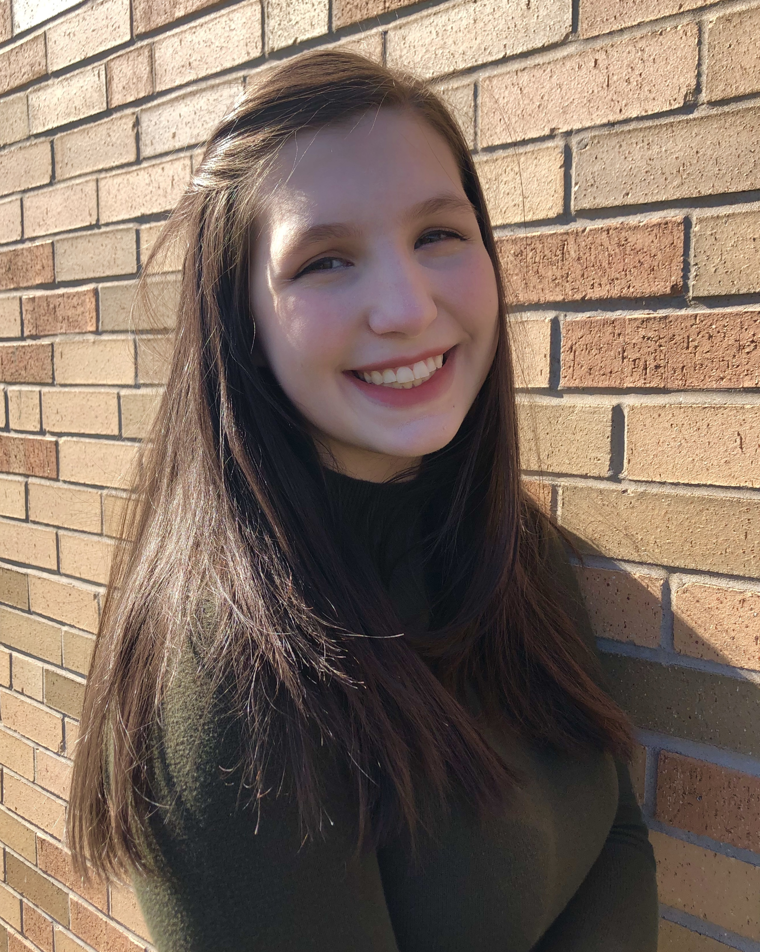

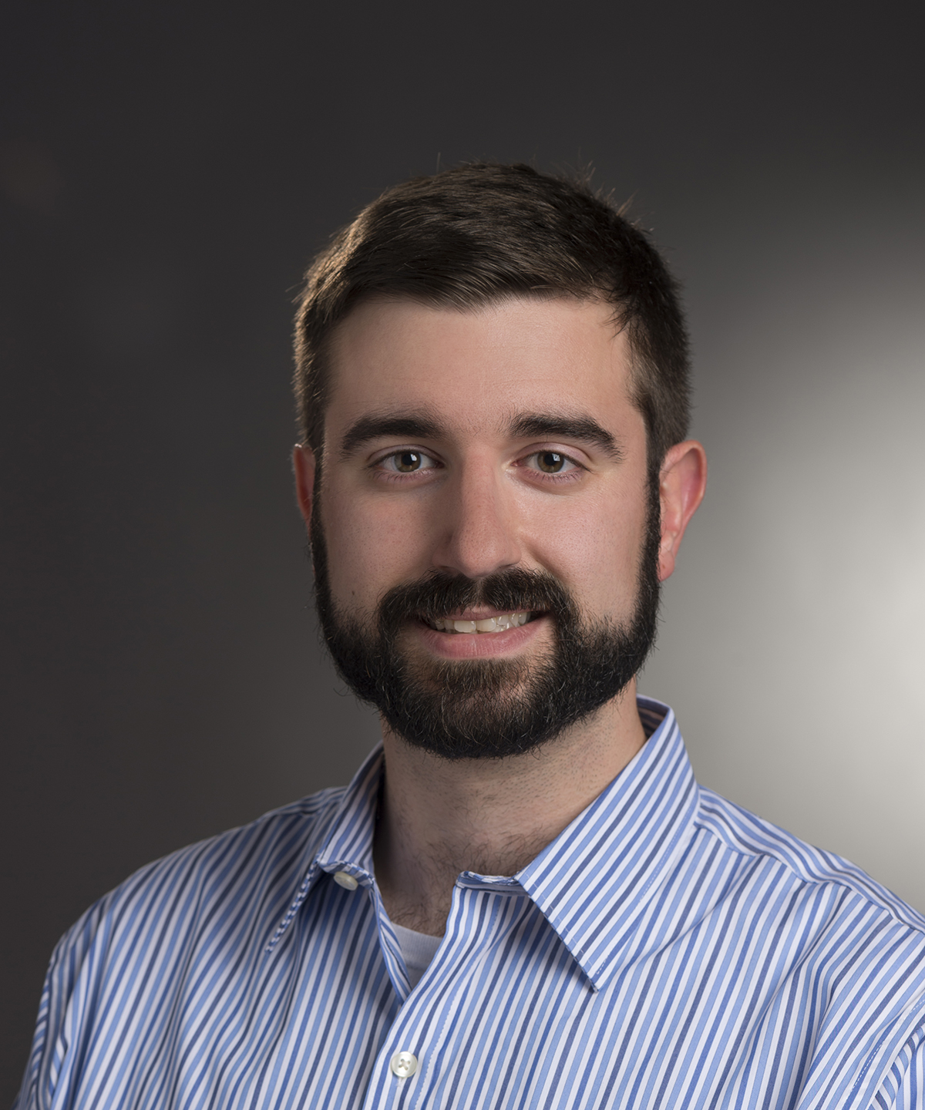

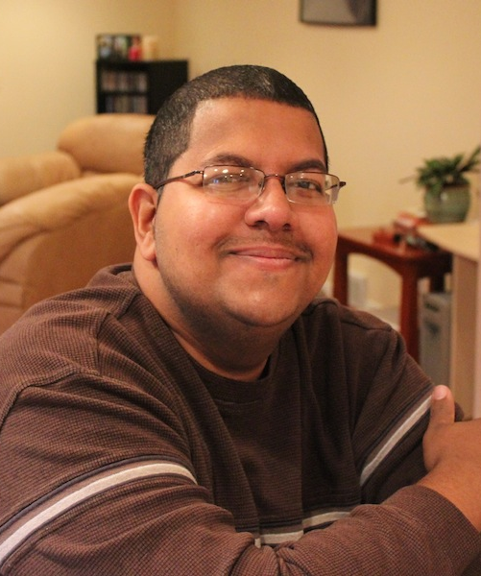
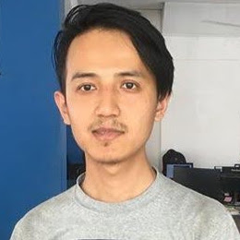
Team
Tristan Chavez
Sarah Smith
Shweta Wahane
Alex Ororbia
Cecilia O. Alm
Reynold Bailey
Rajesh Titung

Slide 3
Research Questions
In developing a recurrent neural network (RNN) model to predict confusion from a collaborative task using several data streams:
R1: Which features from each type of data are most relevant to detecting confusion?
Facial action units, eye tracking, galvanic skin response, full body motion capture, speech transcript
R2: How well does a multimodal approach to confusion detection perform? Which modalities are ideal?

Slide 4
Related Work
Expanding on previous studies on developing machine learning algorithms to predict confusion during collaborative tasks:
2-participant interaction via Zoom
After experiment, subjects watched their own videos and rated level of confusion
Kaushik et al. (2021) Considered facial action units and speech transcripts Review portion wasn’t precise due to discrete 30-second timespans Model based on random forest | Mince et al. (2022) Additionally considered audio (prosodic) cues Review tool allows for continuous confusion rating Model based on RNN

Slide 5
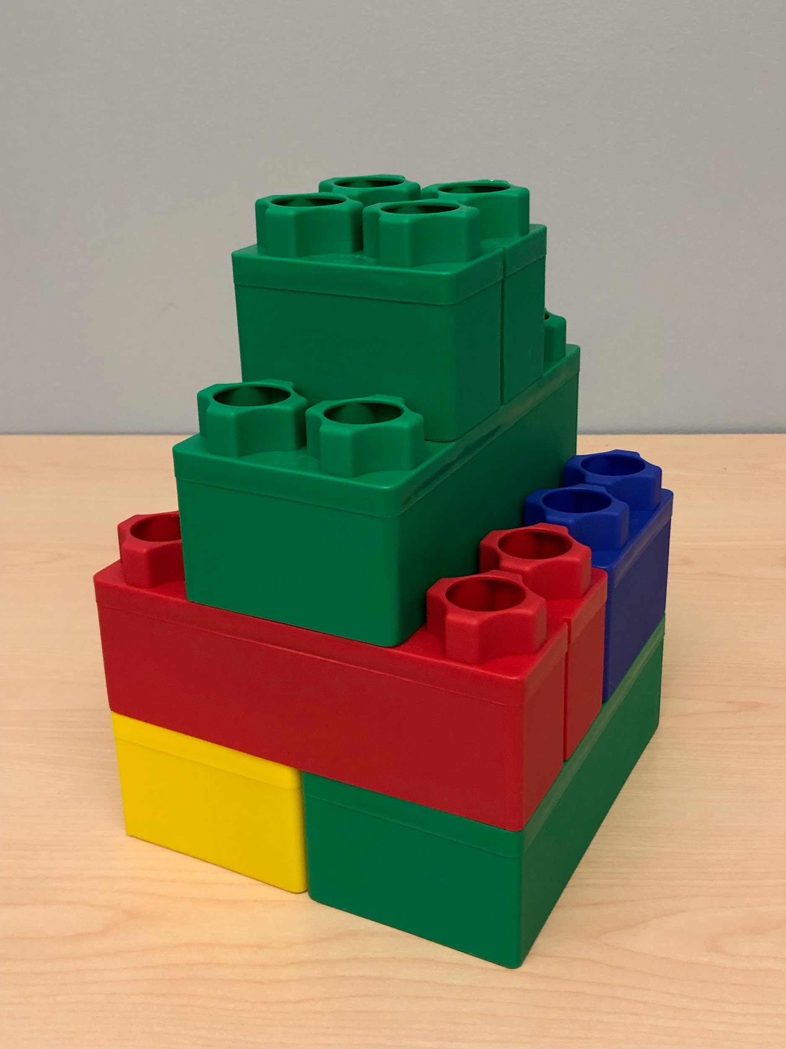
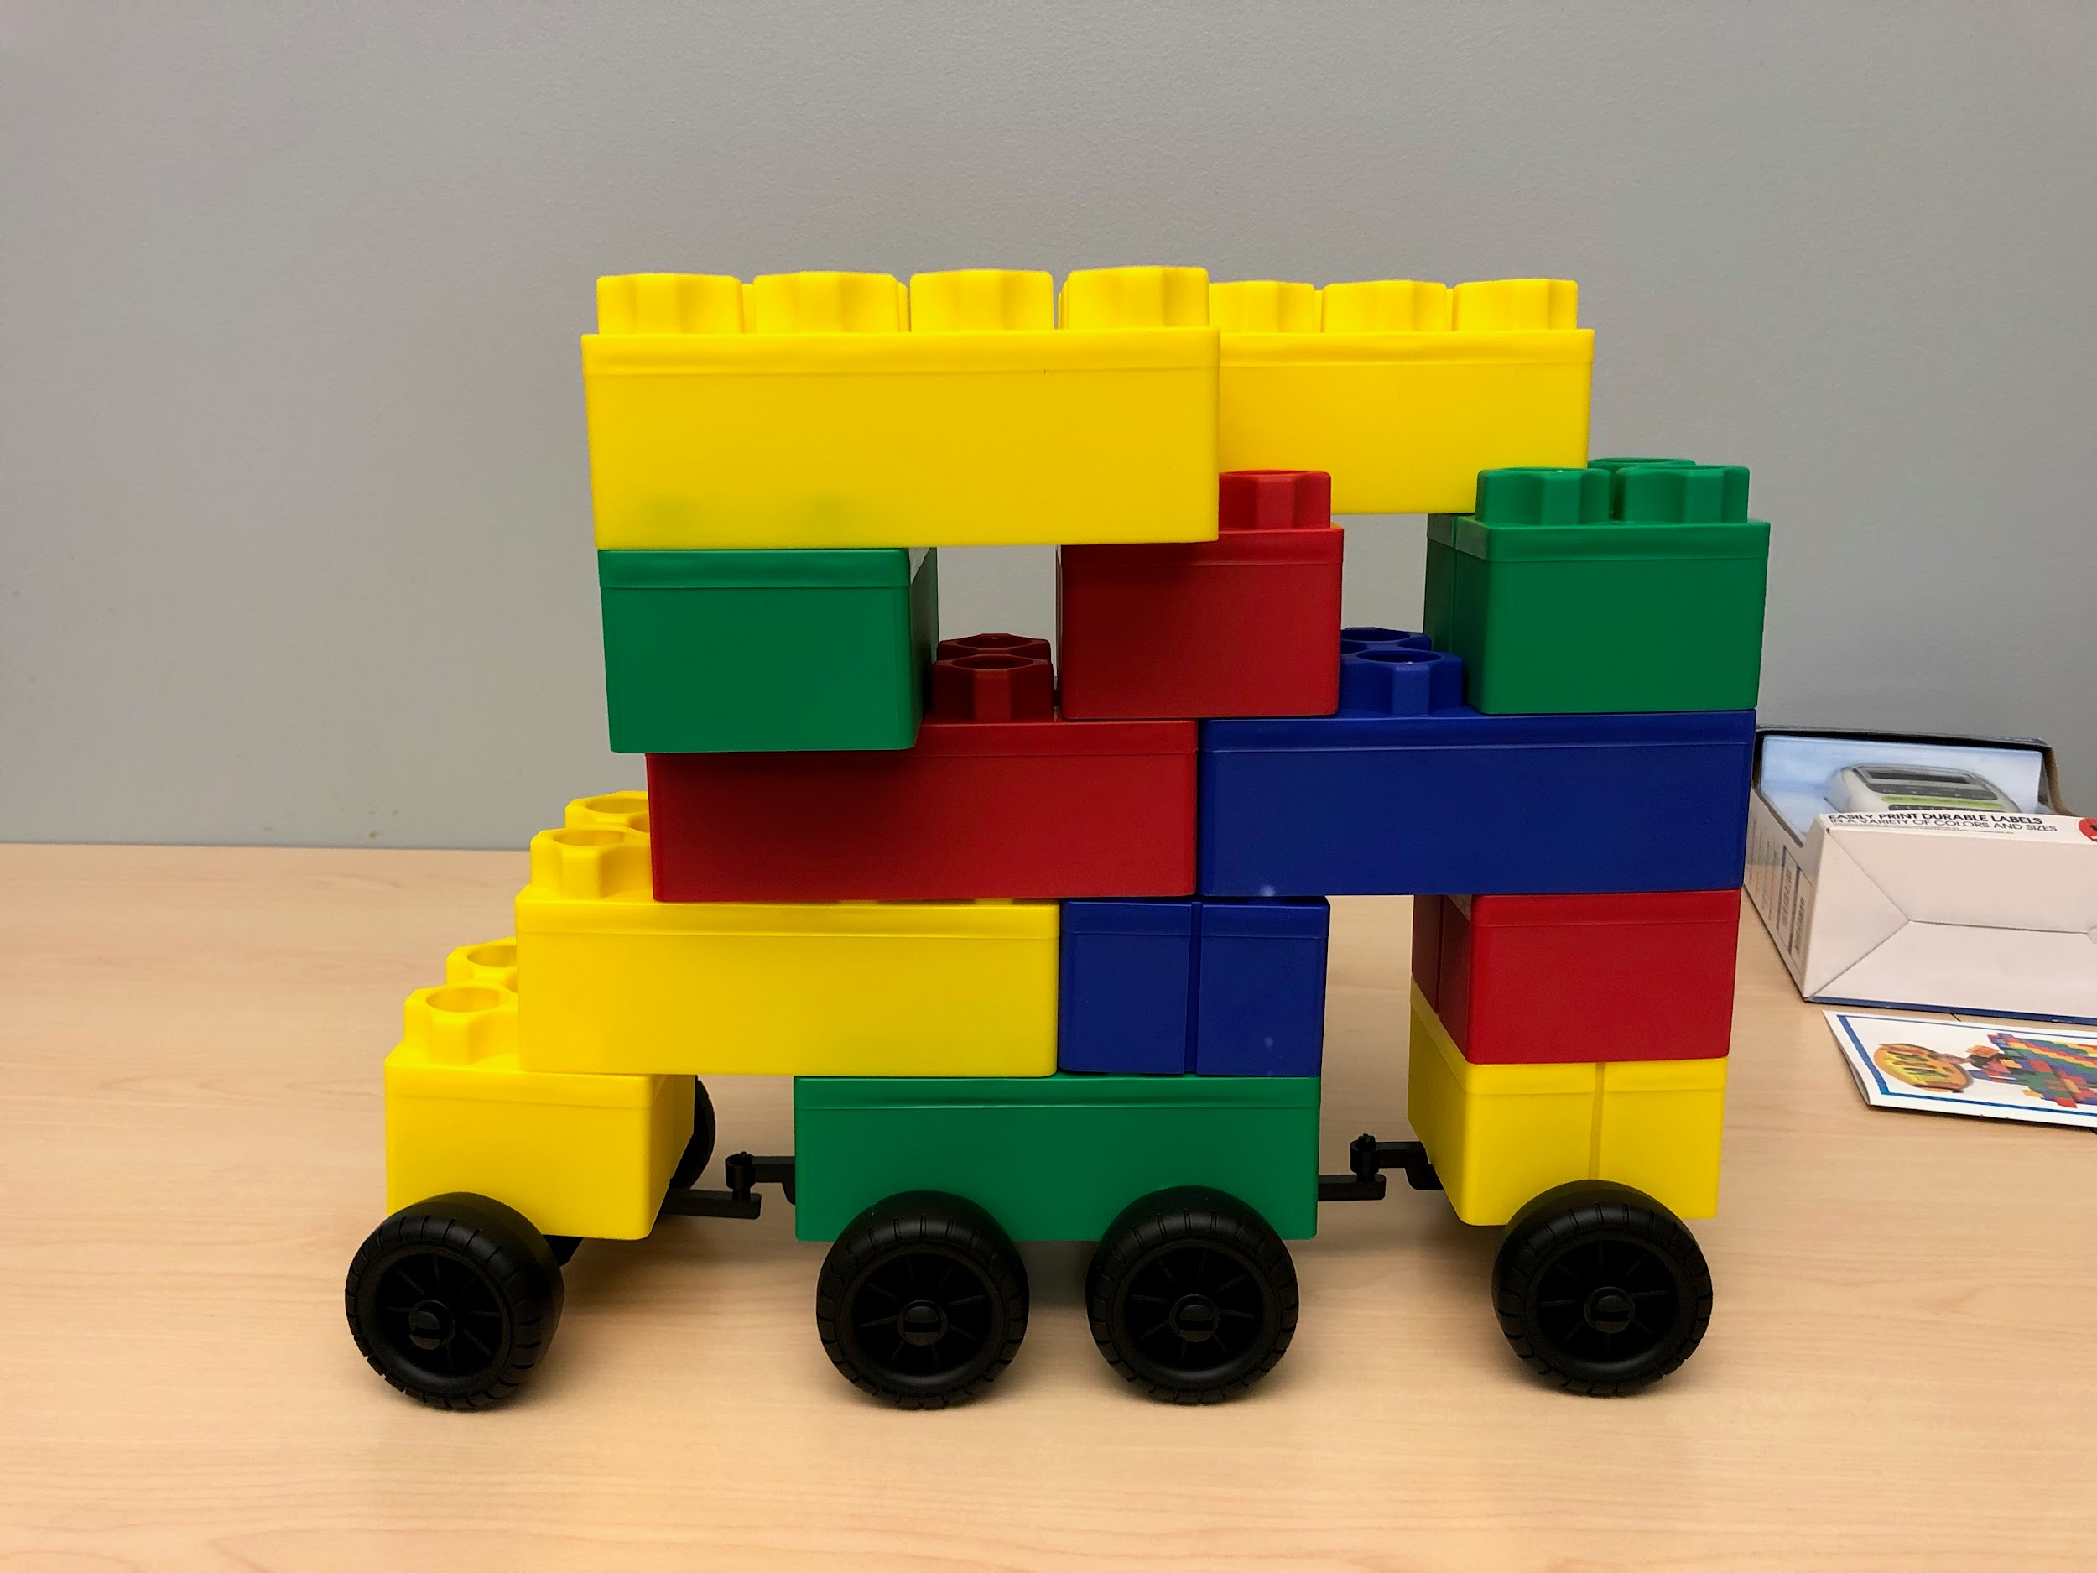
Approach and Methods
Multimodal approach - several data streams for two participants
Participants equally split into Instructor and Builder roles
Work on two cooperative tasks consisting of assembling
building blocks according to diagrams given to the
Instructor
Half of Builders are given instructions to be periodically
Uncooperative to create a cognitive disequilibrium
which has been proven to induce confusion
(Lehman et al. 2011)
Use Mince et al.’s tool to watch the recording and continuously rate confusion
Data from each modality will be recorded and
processed for analysis by the recursive neural network

Slide 6
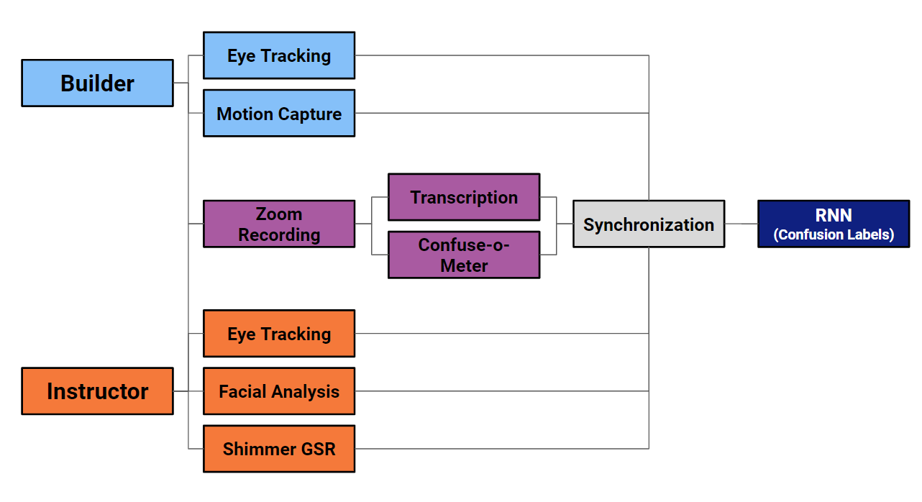
Approach and Methods

Slide 7
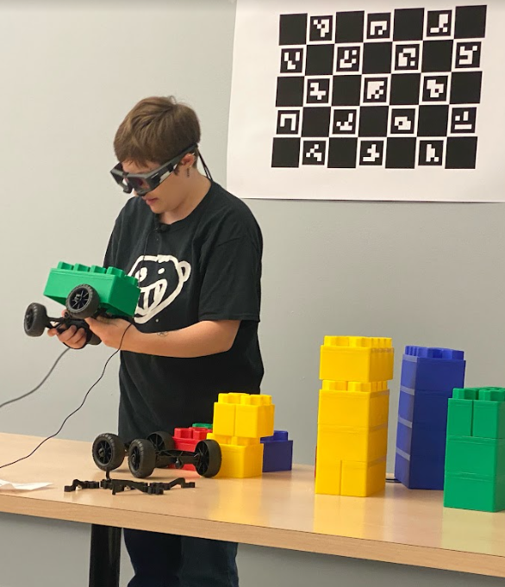
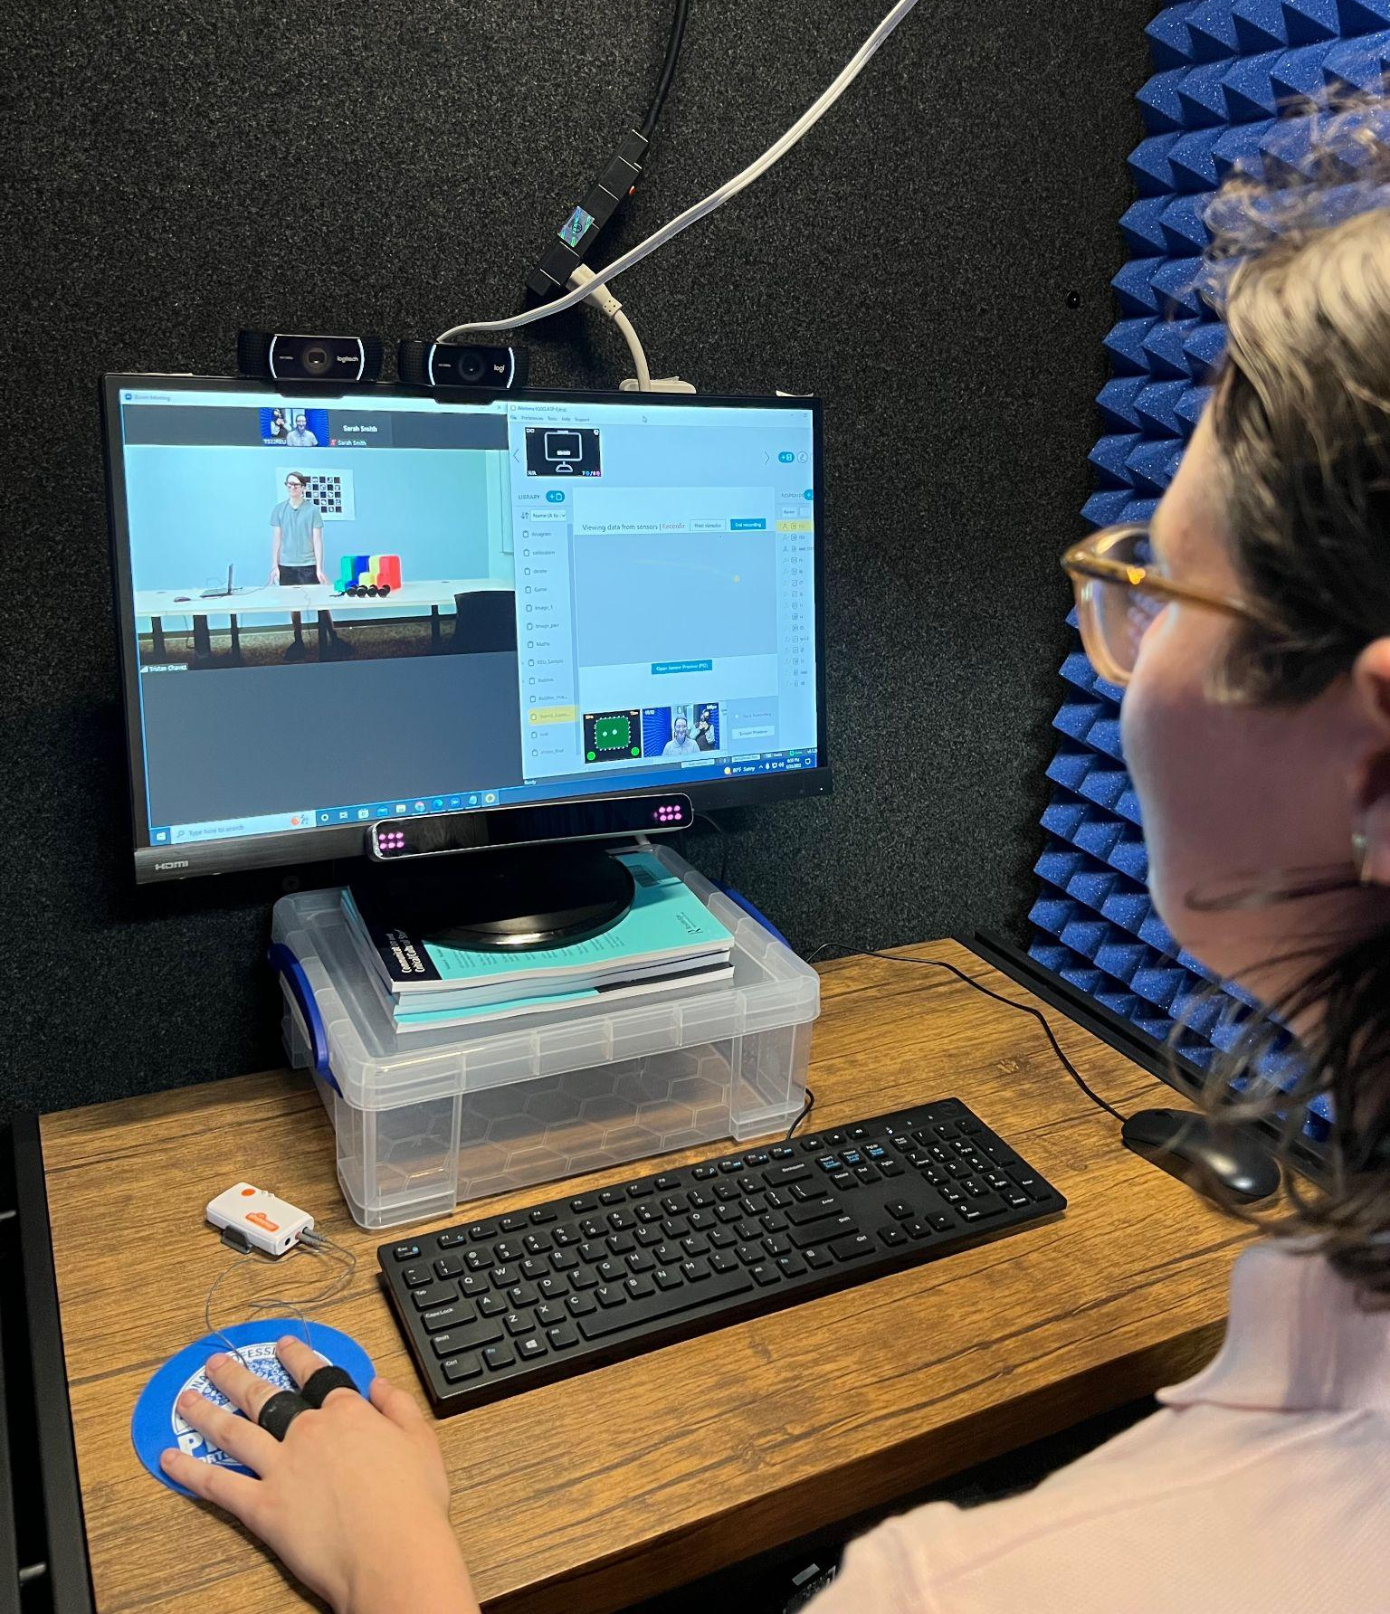
Setup
Builder in GOL 3660
Instructor in CLaSP Lab

Slide 8
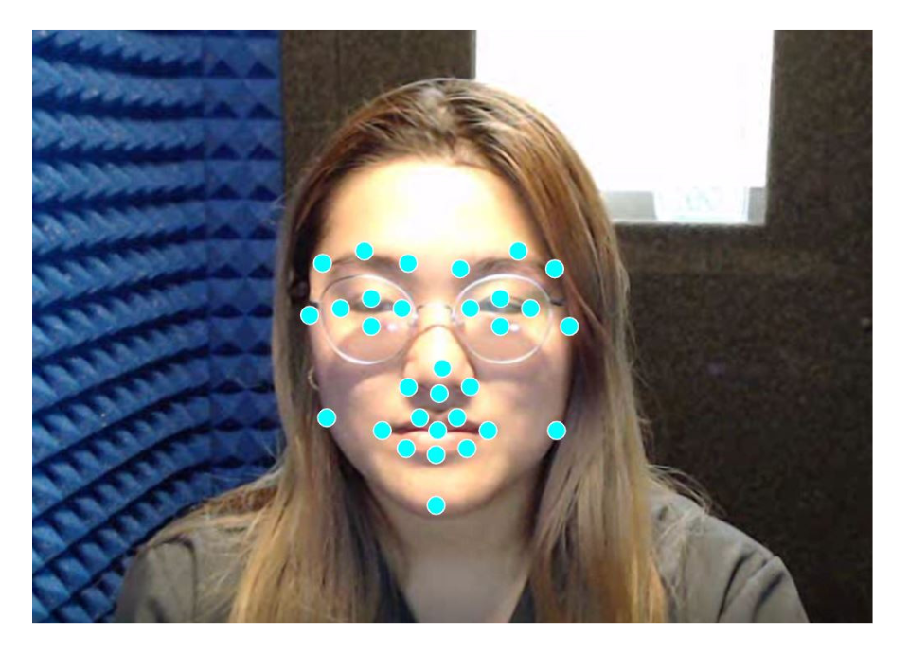
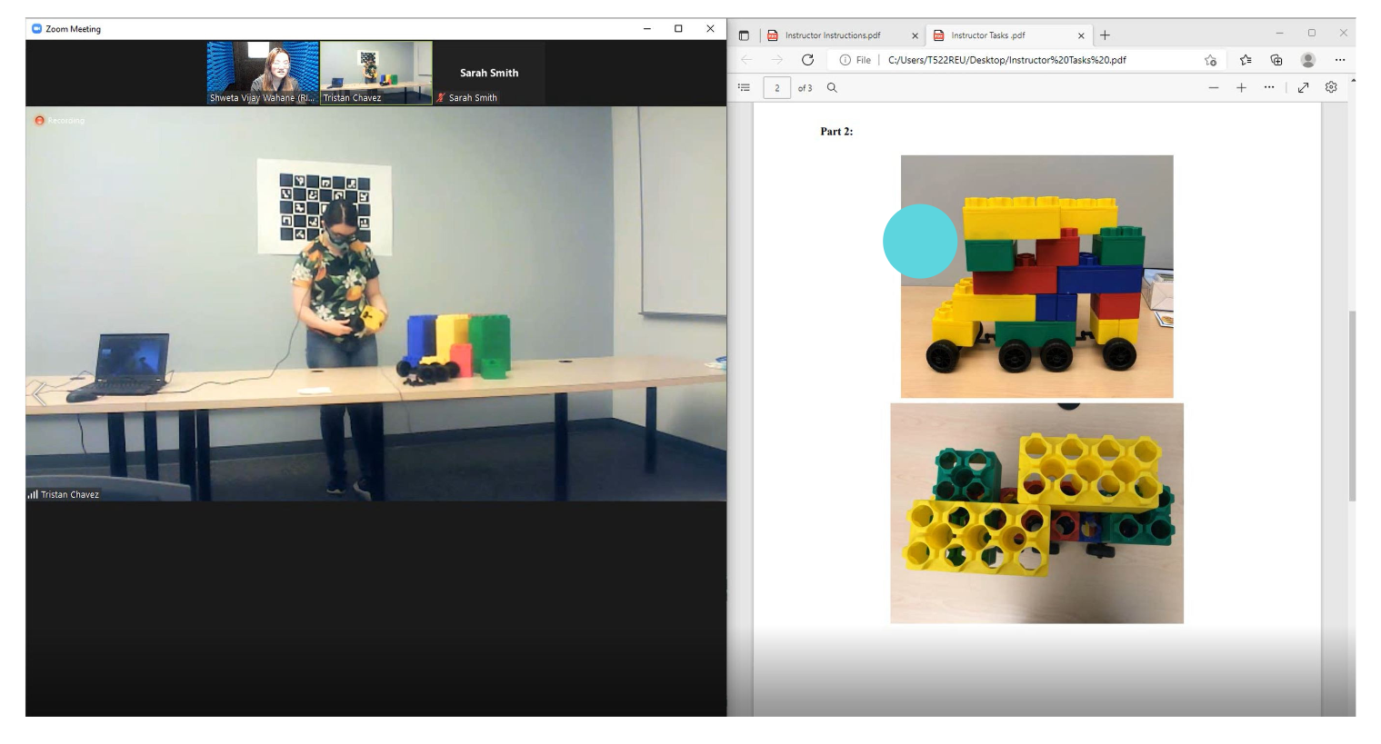
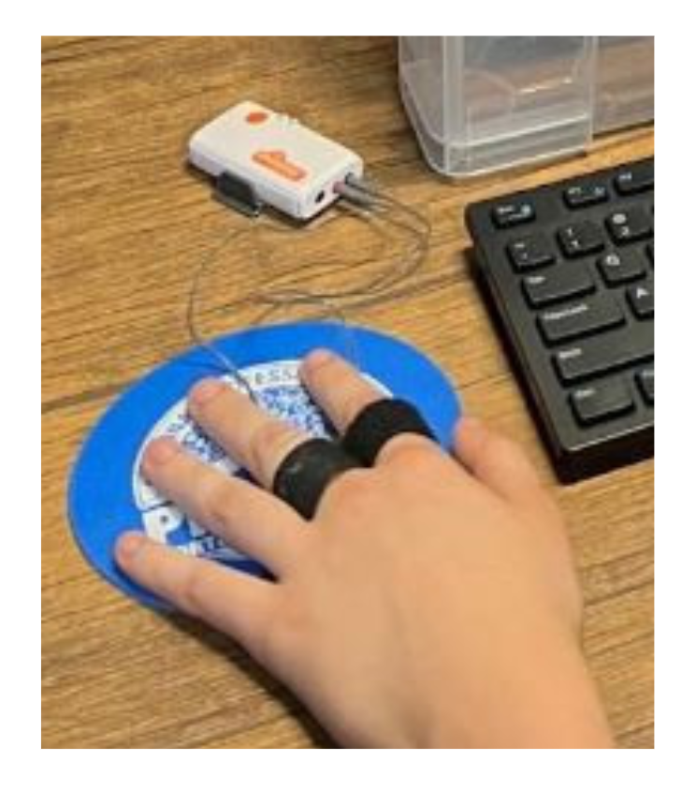
Setup
Instructors: Shimmer GSR sensor, facial features and gaze tracked by iMotions

Slide 9
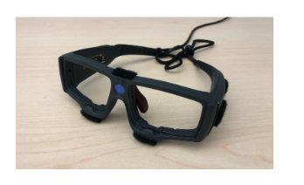
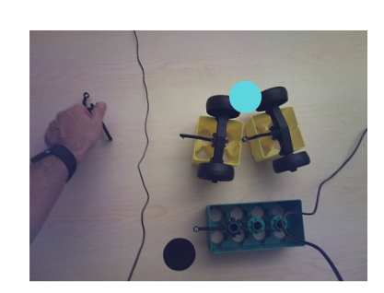
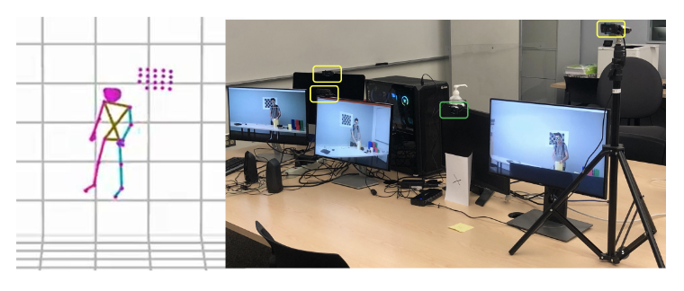
Setup
Builders: SMI eye tracking glasses using iView and BeGaze, body movements recorded by FreeMocap

Slide 10
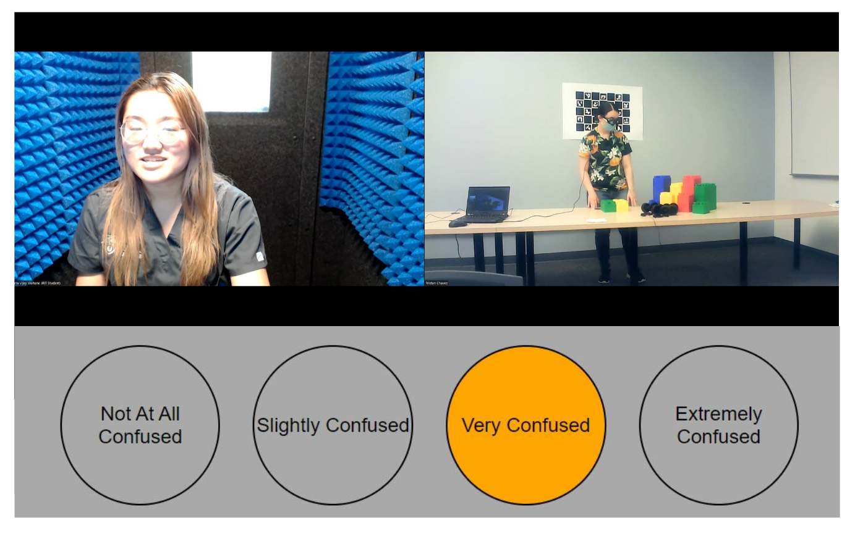
Setup
Both Participants: Transcript of Zoom call (divided by speaker), Confuse-o-Meter ratings

Slide 11
Features Used
Role | B or I
Mocap | Raw Data (flattened Frame x Position x Axis)
SMI Glasses | Event Category, Index Binocular, Pupil Diameter, Area of Interest Name, Gaze Vector (x, y, z)
Dialogue Transcript | Disfluency Features (question, pause, edit word, reparandum, interregnum, repair), Current Sentence Length, Speech Rate, Content (multi-hot encoded)
Facial Action Units | Attention, Brow Furrow, Dimpler, Jaw Drop, Lid Tightener, Mouth Open, Nose Wrinkle
Screen Eye Tracking | Coordinates, Fixations (x, y)
GSR | Conductance

Slide 12
Data Collection Challenges
Lengthy manual task in keyframing SMI Glasses
Several issues with transcript processing packages (IBM Watson, deep-disfluency)
FreeMocap recorded at different frame rates on different cameras so an independent python script had to sync the frames before data could be processed by the RNN
Failure of certain modalities during data collection
iMotions Facial Analysis for Group 2
SMI Glasses for Group 9

Slide 13
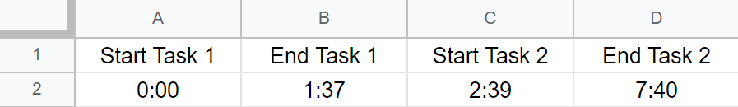
Data Preprocessing
Different rates for the outputs (synchronization)
Freemocap in 15 fps
Confuse-o-meter in deciseconds
iMotions in milliseconds
SMI Glasses in h : m : s : ms
Transcript in seconds
Took first instance at a specific second to synchronize
Data normalized in a max-min range function
Once synchronized by seconds, the data is put into a tensor
Synchronized according to start of task 1
Data in between tasks 1 and 2 is cut out and the data after task 2 as well

Slide 14
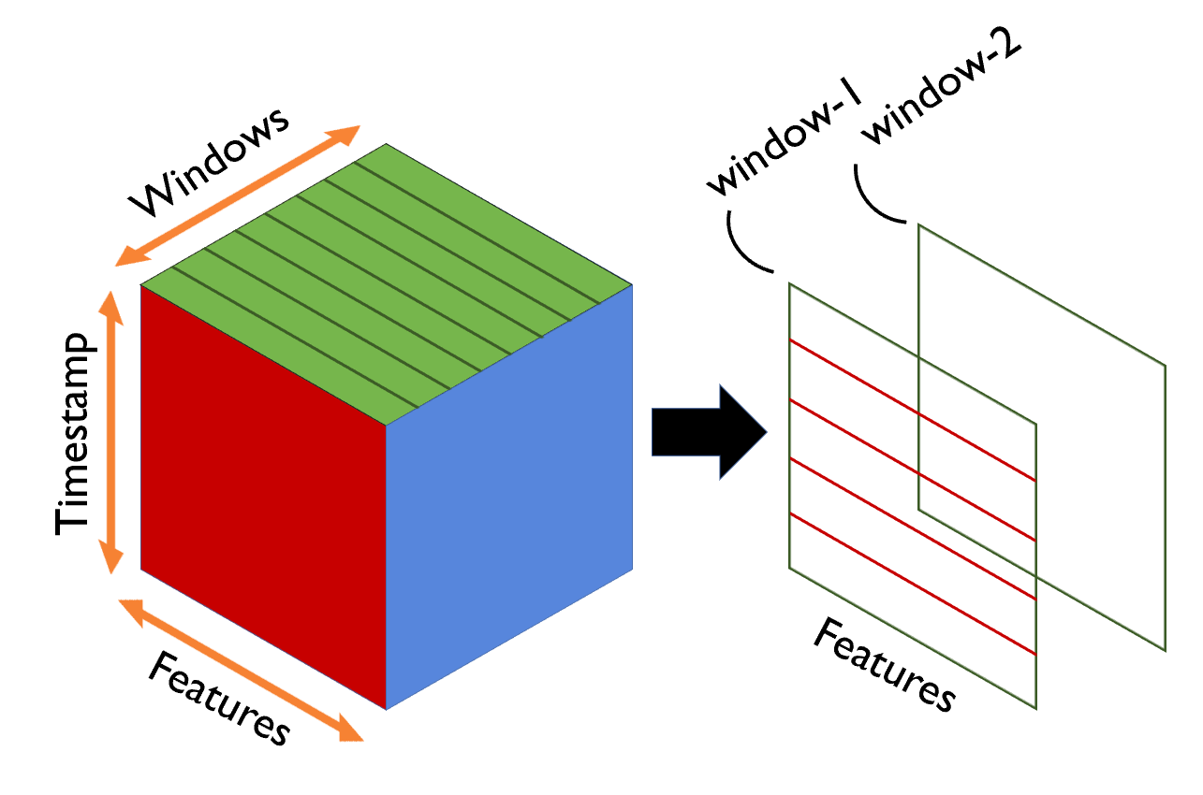
Tensors and TensorFlow
Tensors are functions that operate very similar to lists/arrays in python with the added benefit of neural network support.
First the data is synchronized in accordance to
the Confuse-o-Meter timestamps. This means
trimming off the time before the start of trial 1,
between the two trials, and after trial 2.
To get more randomized data, the subjects are then divided into time windows which were used to create a new tensor.
Setup is Z: Windows, Y: Timestamp, X: Features

Slide 15
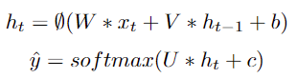
Recurrent Neural Network Model
The windows are than randomly sampled along with corresponding labels to be broken into training and testing datasets
These sets are nonsequential
Uses the softmax activation function
Predicts labels and uses categorical cross entropy (CCE) to compare the output with the actual labels to calculate the gradients
GradientTape holds the gradients from CCE
Adam optimizer function then applies the gradients to the weights

Slide 16
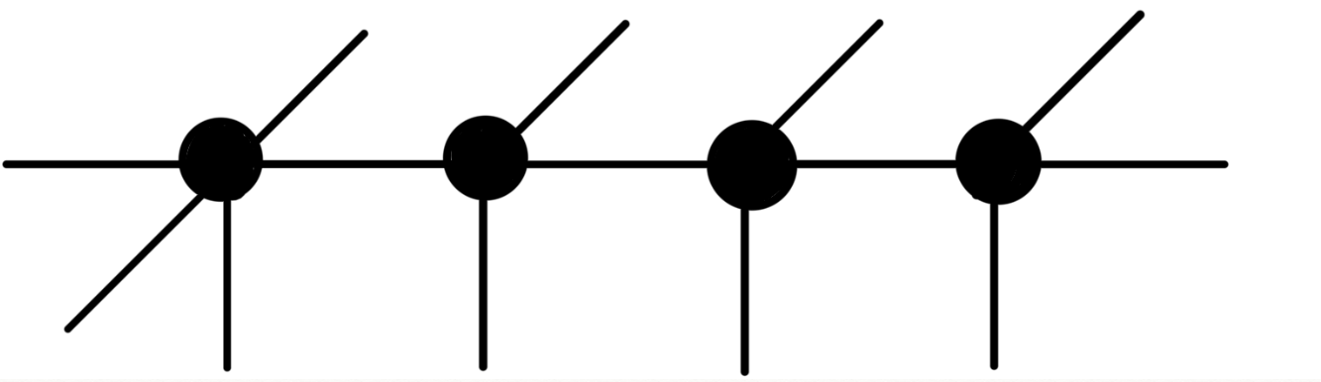
RNN Model
ŷ1
ŷ2
ŷ3
ŷ4
U
U
U
U
V
V
V
V
W
W
W
W
x1
x2
x3
x4

Slide 17
Results
Development of an recurrent neural network (RNN) that is able to be trained on the modality inputs (GSR, eye-tracking, etc.) to predict when confusion occurs
66% accuracy
Extensive high-quality dataset that has been properly synchronized for 32 participants in 16 different trials
Corresponding audio features that have yet to be integrated but are invaluable for studying confusion.
The RNN successfully learned the training set and improved with the validation set over time in regards to accuracy
Struggled to generalize the data to the validation set which made the model’s loss function increase over time.

Slide 18
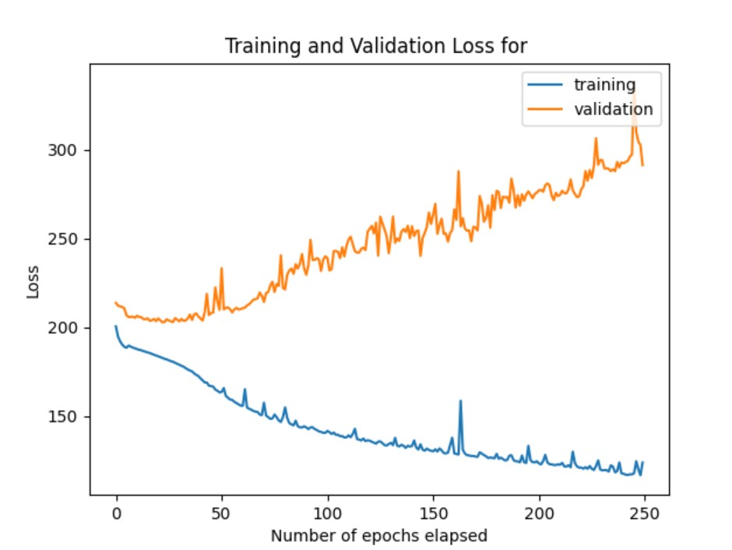
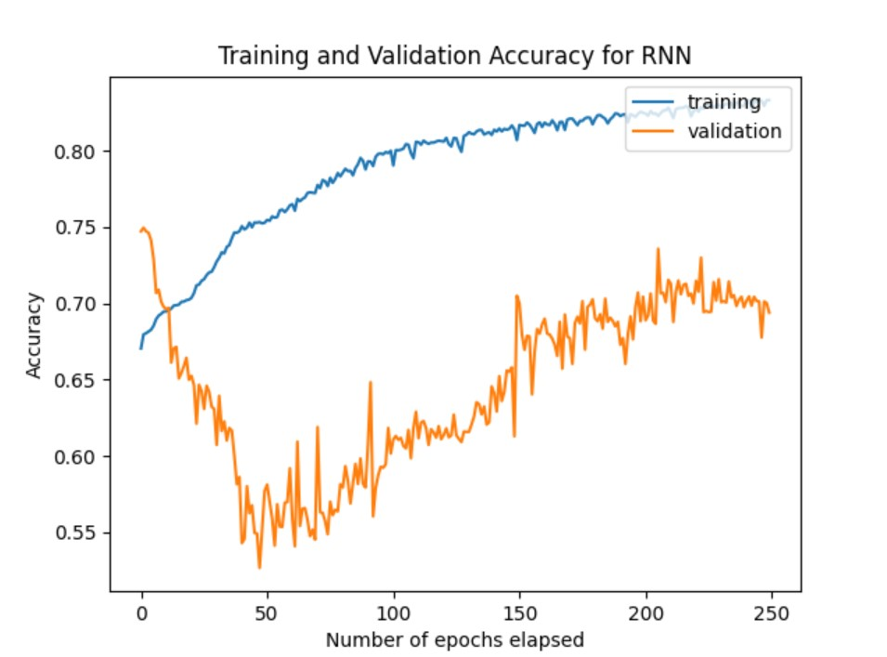
Results Cont’d

Slide 19
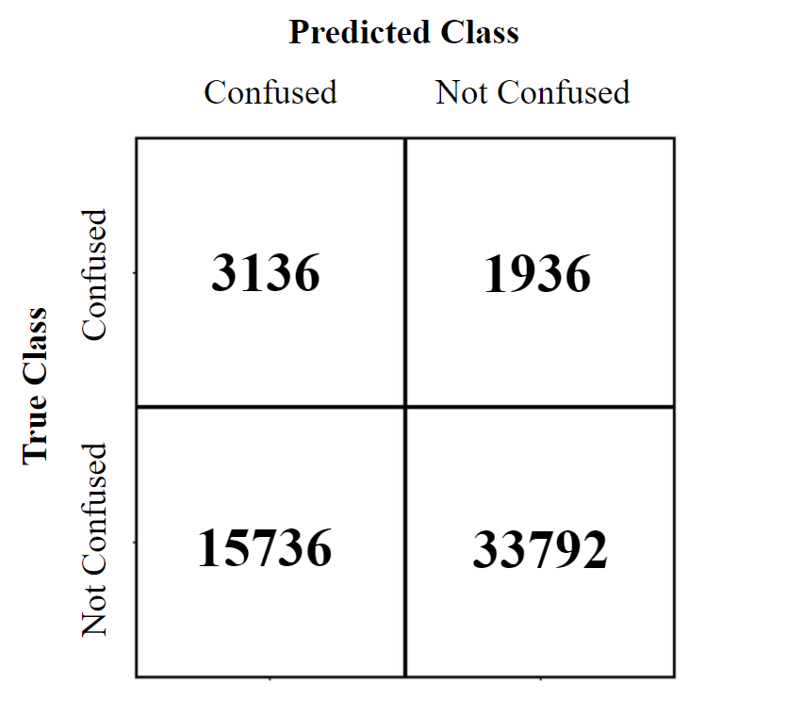
Shortcomings
The precision with which the model
predicted the test set was fairly low for
an acceptable prediction model
This is due in part to an unbalanced
set of data used for the test set which
only had 10% of labels marked as
“confused”.
Certain modalities could be adding more noise rather than helping the RNN predict confusion
The model can only be trained with 13 builders and 13 instructors as the rest are withheld for validation and testing

Slide 20
Next Steps
Addition of audio feature data into the RNN
Experiments with different combinations of modalities as inputs
This will demonstrate the importance of different modalities in the prediction of confusion
Adjustment of RNN hyperparameters for improved accuracy and especially precision
Optimizer, weight initialization and learning rate
Testing the model on just builder and just instructor data may yield better results

Slide 21

References and Acknowledgments
C. Mince, S. Rhomberg, C. O. Alm, R. Bailey and A. Ororbia,
“Multimodal Modeling of Task-Mediated Confusion,” Fc. 2022.
N. Kaushik, R. Bailey, A. Ororbia and C. O. Alm, "Eliciting Confusion
in Online Conversational Tasks," 2021 9th International Conference on Affective Computing and Intelligent Interaction Workshops and Demos (ACIIW), 2021, pp. 1-5, doi: 10.1109/ACIIW52867.2021.9666351.
Lehman, B.; D’Mello, S. K.; Strain, A. C.; Gross, M.; Dobbins, A.; Wallace, P.;
Millis, K.; and Graesser, A. C. 2011. Inducing and tracking confusion with contradictions during critical thinking and scientific reasoning. In Biswas, G.; Bull, S.; Kay, J.; and Mitrovic, A., eds., Artificial Intelligence in Education, 171–178. Springer Berlin Heidelberg.
This material is based upon work supported by the National Science Foundation under Award No. IIS-1851591. Any opinions, findings, and conclusions or recommendations expressed in this material are those of the author(s) and do not necessarily reflect the views of the National Science Foundation.

Slide 22
Questions?

